Slide 1


Predatory Behavior
Harold H ALNWFL 2025
Original Info From FRSC Pamphlet

Slide 2
Predatory Behavior
This information was gathered by addicts, for addicts about a behavior that has the potentiality to damage, destroy lives and create havoc in the fellowship.
Collectively and individually addicts have been expressing concern about the health and welfare of our fellowship if this behavior does not abate.
Local and State officers, whether it be drug court or probation officers etc. that will not send their probationers or offenders to Narcotics Anonymous.

Slide 3
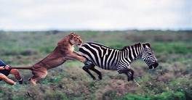
Predatory Behavior
Many people who could become potential members are not able to hear the lifechanging message of Narcotics Anonymous.
There is a reputation in some areas that people who are sent to NA are not safe and are preyed upon by other members.

Slide 4
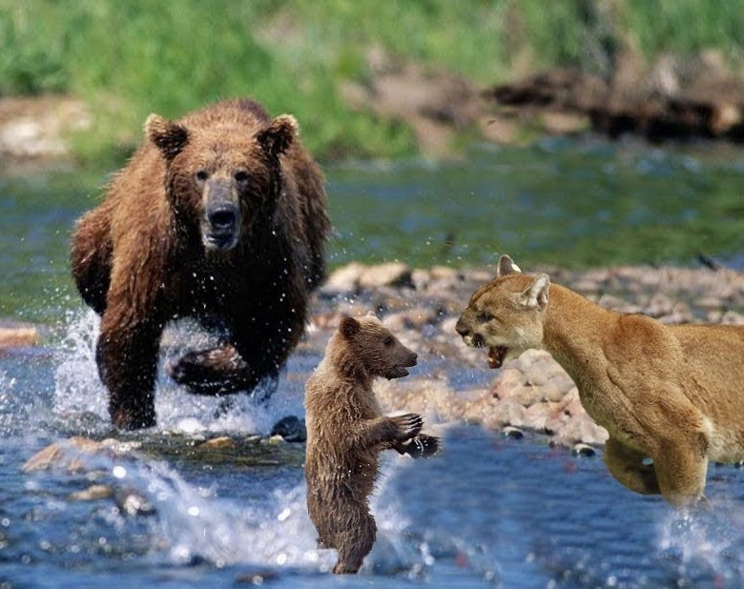
Predatory Behavior
Many people who could become potential members are not able to hear the lifechanging message of Narcotics Anonymous. There is a reputation in some areas that people who are sent to NA are not safe and are preyed upon by other members.

Slide 5
Predatory Behavior
Our hope is that we can bring to light some information that will help recovering addicts identify where there has concern and how to deal with the situation if and when the situation it arises. Most of all it will hopefully cause people who are engaging in predatory behavior to take a good long look at just how damaging this behavior can be to addicts in our fellowship and those who have yet to join us.

Slide 6
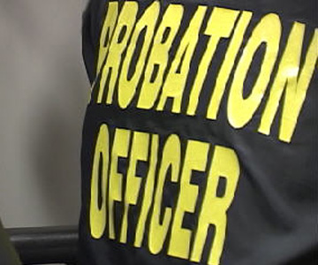
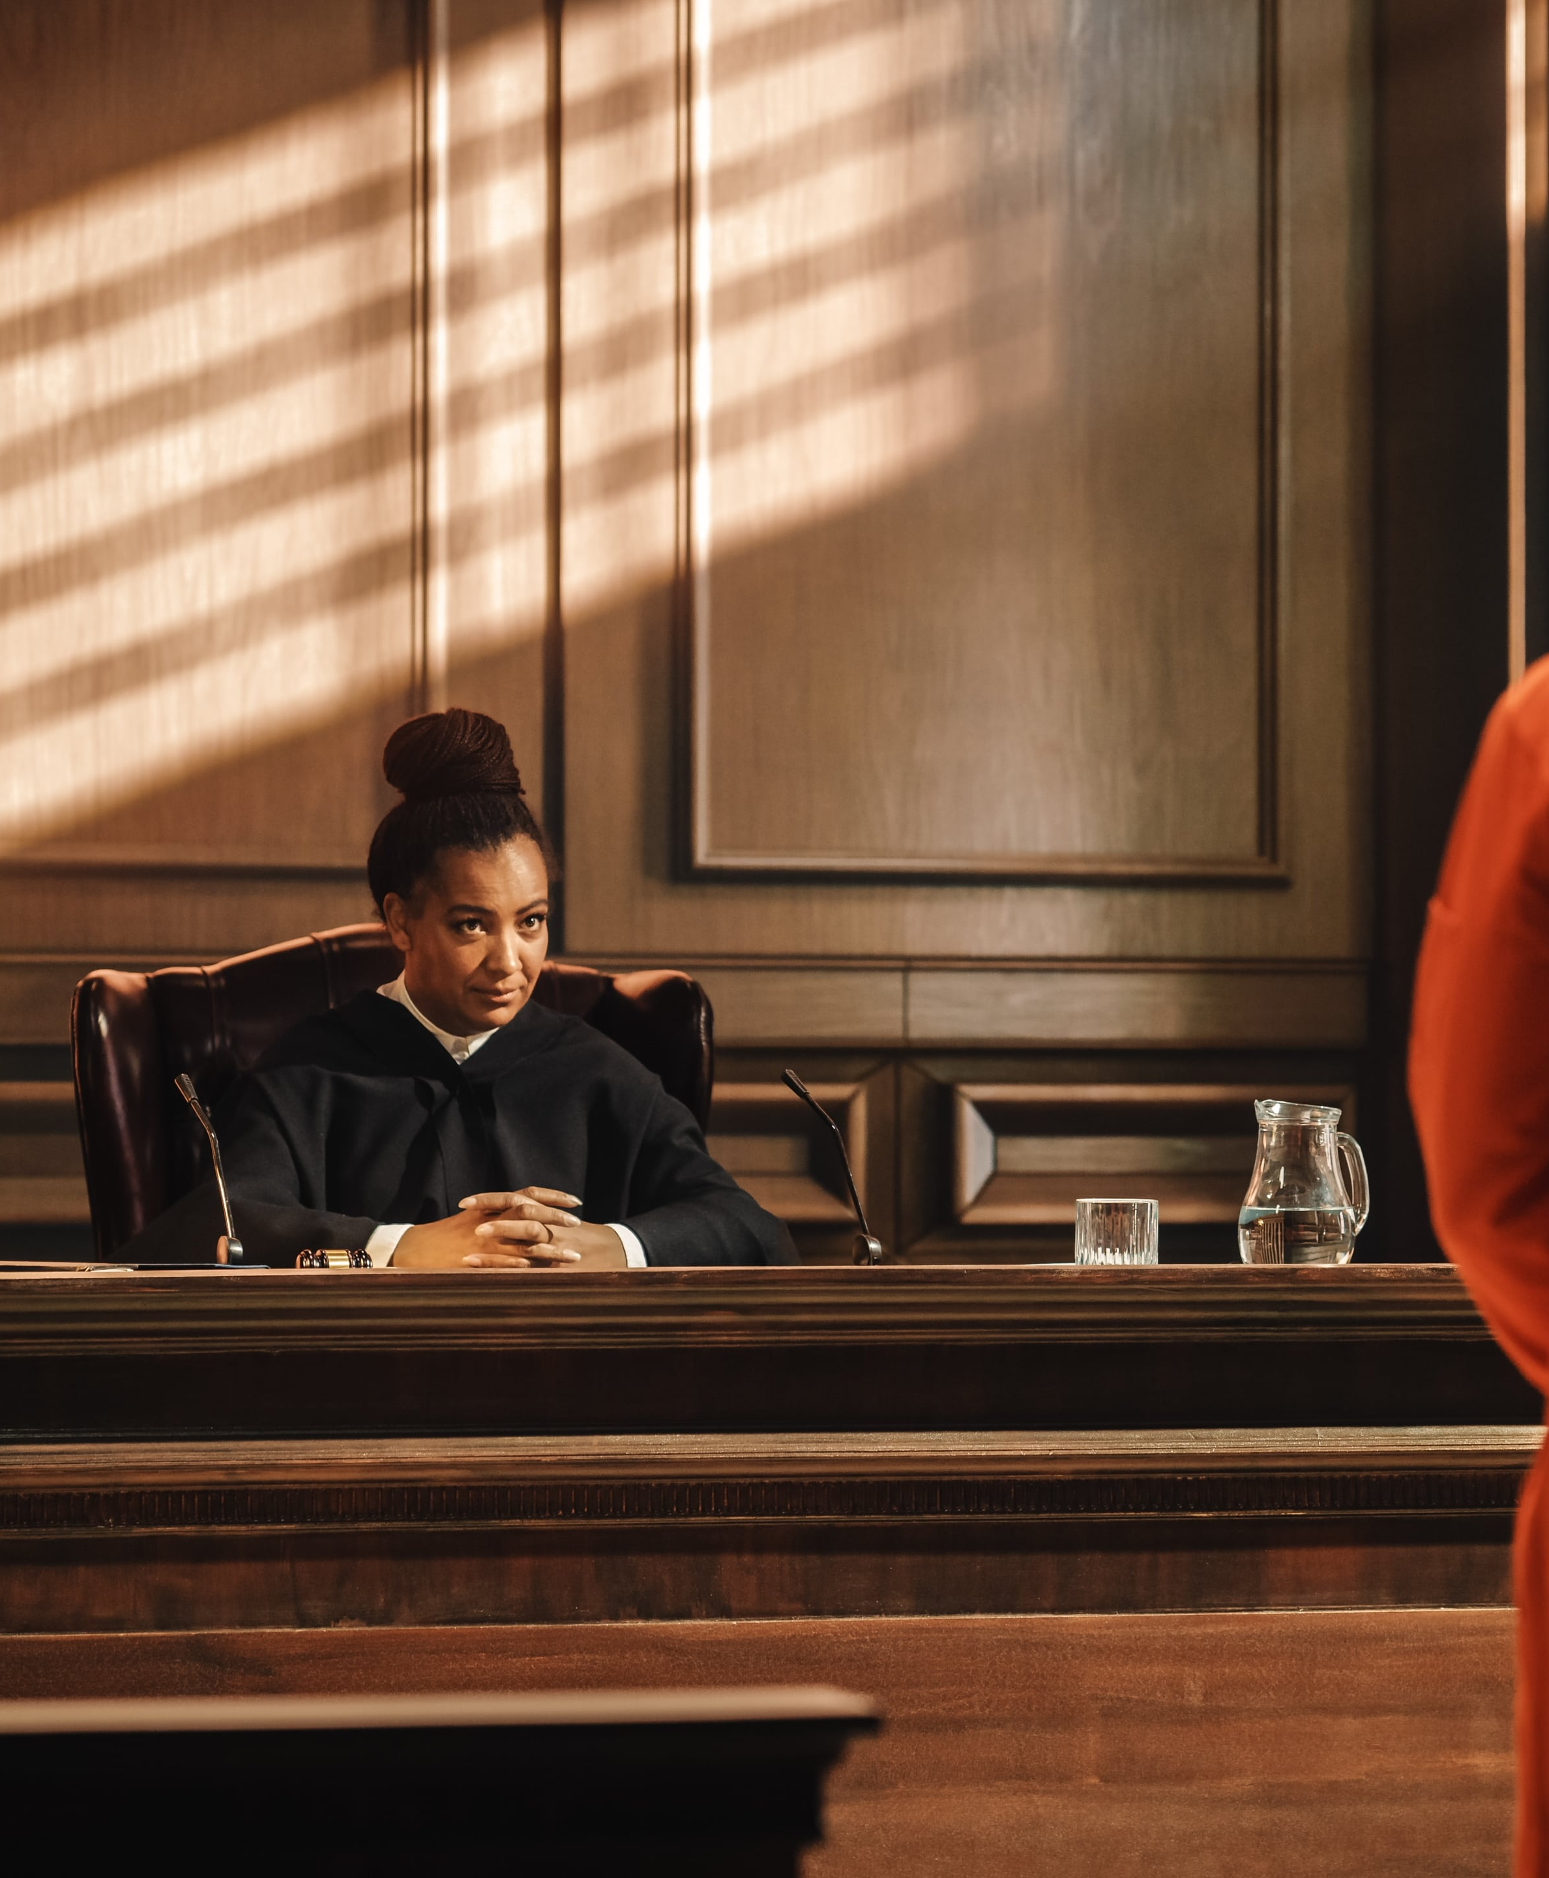

Predatory Behavior
What’s at stake is, Local and State officers, whether it be drug court or probation officers etc. They may not be willing to send their probationers or offenders to Narcotics Anonymous.

Slide 7

Predatory Behavior
Many people who could be potential members are not able to hear the life changing message of Narcotics Anonymous. There is a reputation in some areas that people who are sent to NA are not safe and are preyed upon by other members.

Slide 8

Predatory Behavior
Our hope is that we can bring to light some information that will help recovering addicts identify where there has been concern and how to deal with the situation, if and when it arises.
Most of all it will hopefully cause people who are engaging in predatory behavior to take a good long look at just how damaging this behavior can be to addicts in our fellowship and those who have yet to join us

Slide 9
Predatory Behavior
PREDATORY-of or living by plundering and robbing, preying on other animals
PLUNDERING-to take by force or fraud
BEHAVIOR-way of behaving, conduct or action. Something that can be observed and measured.

Slide 10
Predatory Behavior
When we think about predatory behavior in the NA fellowship, we can all come up with scenarios or pull from our own experiences of
Being either predator, prey or witness to these scenarios.
We come to the rooms of NA from varying walks of life or varied reasons and in various stages of addiction.
Some of us will turn from prey into predator. Often times, people who are abused will be come abusers.
Many of us have been abused; some of us have been abusers.

Slide 11
Predatory Behavior
People come to the rooms for differing reasons. Not everyone who is in the rooms is here to “…stop using, lose the desire to use, and find a new way to live”.
Some of us weren’t parented, or didn’t have adequate role models.
Some of us were raised in decent loving homes and strayed from the path.
Some come to the rooms through the criminal justice system.

Slide 12
Predatory Behavior
We all arrive in the rooms because something is wrong with the way we are living and we need to find a different way to live.
Many arrive at the doors of NA, broken, battered or badly damaged by the disease of addiction and the lengths we had to go to so we could continue using.
Many of us arrive with the “scars” of addiction and/or abuse evident on our physical person, others carry those wounds deep within.
You may not be able to see them, but the scars are there.

Slide 13

Predatory Behavior
When we think about predatory behavior, we may only think about sexual predators but there are many kinds of predators in our midst.
Examples of predatory behavior could be;

Slide 14
Predatory Behavior
borrowing money with no intention of paying it back, borrowing possessions
bumming” cigarettes, etc from a person who you know is unable to say no.
It could be someone selling or attempting to sell drugs in or around our meetings.
It could be an attractive person currying favor from someone to get money or things.
It could be a person with time “scooping up” a newcomer and beginning a relationship with someone who is newly clean (thirteenth stepping).

Slide 15
Predatory Behavior
Many people will resort to getting in relationships after the drugs go. It is one of the most prevalent and natural decisions people make when getting clean.
Using relationships to feel better is very common when people are getting clean.
When the drugs go people look for something outside themselves to fill a void left by active drug use.
Often times, the newcomer is excited or thrilled that someone with time is interested in them. They may not know yet that they don’t have to get involved in romantic/sexual/intimate relationships to stay clean.

Slide 16
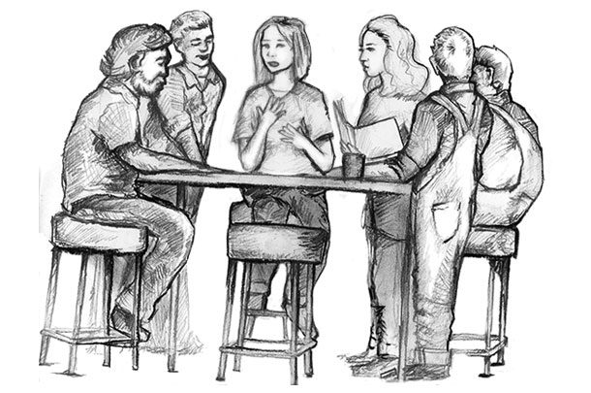

Predatory Behavior
There are several relationships that are imperative for early and on-going recovery:
a relationship with a fellowship, a sponsor,
a support/peer group,
the steps
a home group,
a service position,
consistent meeting attendance schedule etc.

Slide 17
Predatory Behavior
Adding a romantic or sexual relationship at an early stage of recovery can shift the focus off of recovery and onto the new relationship. This can happen subtly without the people involved even knowing. When someone, female or male gets involved in a romantic/sexual/intimate relationship with someone who is new or returning to NA it is a problem for both parties. It may not be evident immediately but ultimately it could cause damage.

Slide 18
Predatory Behavior
People come into the rooms of NA, and many have issues with interpersonal relationships.
Many were raised in abusive homes or have some sort of abuse history.
Some grew up people pleasing to get by; others used manipulation to get what they needed.
Some believe they need to engage in sexual activity to be loved, etc.

Slide 19
Predatory Behavior
Everyone has the right to feel safe to recover in the rooms of NA. We have the responsibility to ensure that the rooms are a safe place for people in any stage of recovery. When the rooms of NA are unsafe for any addict, they are unsafe for every addict. When the rooms of NA are unsafe then addicts may not want to come to the rooms, and they may die. We have a responsibility to make the rooms of NA as safe as possible. This may require that this behavior is confronted when observed.

Slide 20
Predatory Behavior
Talking to people who are engaging in this behavior should be considered like doing a twelfth step call, this should not be done alone.
Some may believe that confronting someone with more than a one-on-one would be intimidating.
There is strength in numbers and we are more likely to act with spiritual principles if someone is there to support us.
Some believe that this is “an outside issue” and we don’t have the right to confront people engaging in this sort of behavior.
We need to ensure that we are coming form a place of love and compassion when talking with someone about this sort of behavior. It says in our literature that ‘we are each others’ eyes and ears” this implies that it is acceptable even advisable to approach someone who is engaging in predatory behavior and explaining why this behavior is dangerous.

Slide 21
Predatory Behavior
Does the Tenth Tradition tell us that, as individual recovering addicts, we must not talk in meetings about the challenges we face? No, it does not.
While a particular problem may be an outside issue, its effect on our recovery is not; everything affecting and recovering addict’s life is material for sharing.
If a problem we are having impacts our ability to stay clean and grow spiritually, it is not an outside issue.

Slide 22
Predatory Behavior
Recommendation/Suggestions that may be helpful.
Home group members should take the lead in making everyone feel comfortable- walking the walk that everyone is welcome regardless….
Get out of your own comfort zone and reach out to groups isolated geographically, by common culture etc.
Creating and maintaining an atmosphere of recovery is up to every individual member setting a personal example for others to follow we can prove that no addict anywhere need die from the horrors of addiction

Slide 23
Predatory Behavior
Recommendation/Suggestions that may be helpful.
It is the responsibility of every home group member to be the eyes and ears of other members and look out for predatory behavior from anyone.
Have 2-3 home group members discuss with the offending member after the meeting. Make a “No Predatory Behavior Tolerated” statement as part of the format • Discuss that this type of behavior is not just sex; it is also money, clothing, rides, places to live. It can evolve into many different behaviors
Confront your friends if they engage in predatory behavior

Slide 24
Predatory Behavior - Conclusion
Every individual is precious to the group and the group is precious to the individual. We never experienced the kind of attention and personal care that we found in the program. We are accepted and loved for who we are, not in spite of who we are. No one can revoke our membership or make us do anything that we do not choose to do. If a predator interferes with our purpose, then addressing that becomes our primary purpose.
Creating and maintaining an atmosphere of recovery is up to every individual member setting a personal example for others to follow where we can prove that no addict anywhere need die from the horrors of addiction.

Slide 25

Predatory Behavior
Questions?

