Slide 1



ALNWFLRSC
Public Relation Workshop
October 2024
Harold H
ALNWFLRSC

Slide 2

Public Relations Workshop
Session One
Building Public Relations Committee
Session Two
Effective Services
and
Planning Presentations to the Public

Slide 3
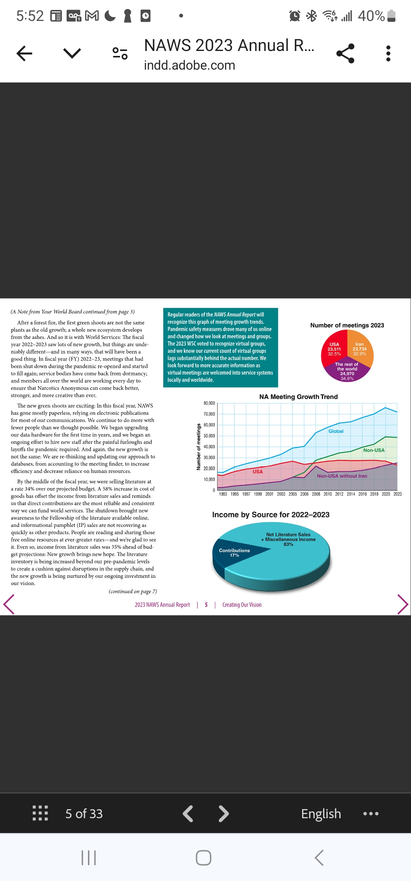
da
Data From 2023
Annual Report

Slide 4
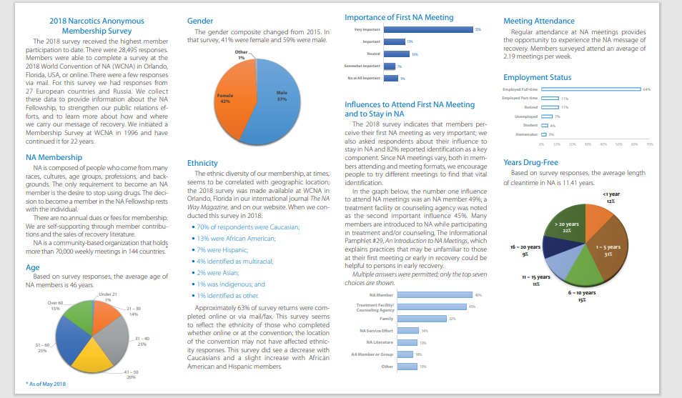
Latest Membership Survey

Slide 5
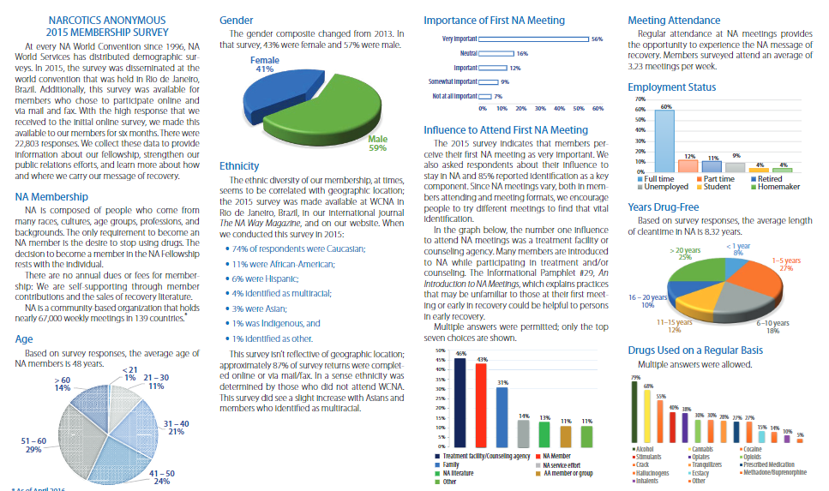
Latest Membership Survey

Slide 6
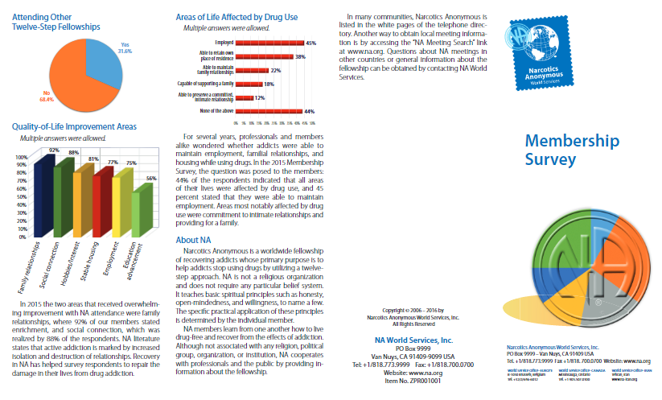
Latest Membership Survey

Slide 7
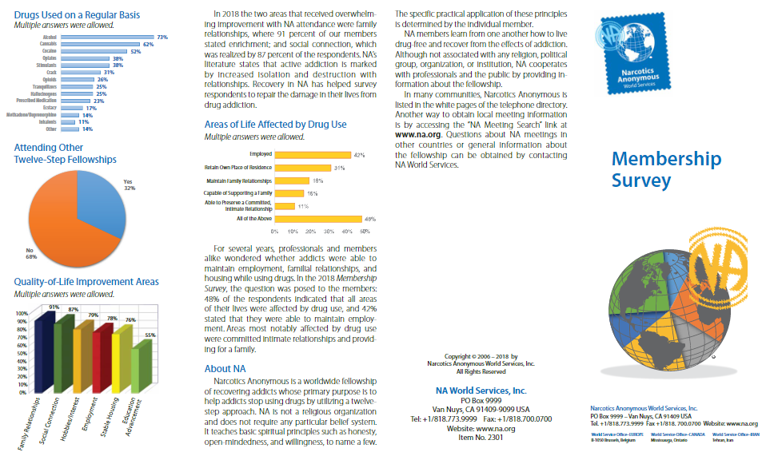
Latest Membership Survey

Slide 8
Building Public Relation Committees
Session One
Building Public Relation Committee

Slide 9
Building Public Relation Committee’s
First identify the responsibility of the Region
Then have the Regional PR person(s) start the recruiting process for local PR with the help of the RCM’s
This will take some time but possible.

Slide 10
Building Public Relation Committee’s
Regional PR person(s) will probably need to help with finding task and mentorship until a committee is formed.
Help with outlines and goals. Have local PR meetings with the chair(s), it is much easier knowing that most people are using a virtual platform.

Slide 11

Key Points
Find leaders that speak well
Help them by finding things to do in their local area
Hold a local workshop on building their Public Relations
  Make it attractive
  Make it Fun
Share tasks, the same people should not be doing everything
Make sure everyone has a task
  Members will lose interest or not return

Slide 12
Task Ideas
Communication between local treatment facilities
Collaboration with Jails & Institutions
Poster Day, make it fun
  contest who can hang the most posters, have to provide photo of it hanging and the name of the store owner who gave permission
Collaborate with neighboring Areas
Education, DA / Legal Services
Local radio and TV stations for time to have public service announcement

Slide 13
Task Ideas
Bus benches, buses
Law enforcement / EMT / Firehouses
PSA’s in the hospitals
Help with helplines in rural areas and/or overseas
Billboards
Contacting local medical communities
Adding information in the Public Library
Going into drug courts
Homeless shelters
Social Media
Federal prisons

Slide 14
Public Relations Workshop
Questions ?
Comments ?

Slide 15
Public Relations Workshop
Session Two
Effective Services
and
Planning Presentations to the Public

Slide 16
How do we as individual members affect our public image?`
What we say, do, or not do as individual members, affects our relationships with the public and the still suffering addict:
  Are we courteous to one another during and after meetings?
    Newer members see how we behave and make choices about our fellowship. They may also share their views with their PO’s and others.
  Do we welcome newer members?
  Do we clean up after meetings?

Slide 17
How do we as individual members affect our public image (cont.)?`
  Are we respectful to people outside the fellowship, especially those that provide us with our meeting spaces?
  Do we wear NA logos or have NA bumper stickers and then act disrespectfully to others?
  Do we act on PR matters alone?
  Do we share our views on outside issues as if they were the views of NA?
  Do we break our anonymity with members of the press?
  23

Slide 18
Public Relations Goals
We clarify what services NA can and cannot provide to the community.
We make NA members more aware of their role in NA’s public image.
We aim for the public to recognize NA as a positive and reliable organization.
We develop valuable relationships with professionals and the general public.
Notes:
All members have a responsibility to educate members about our behavior outside of meetings, gatherings, etc. and how that can effect our public image. We have to be our own watchdogs.

Slide 19
Effective Services
Chapter 3 PR Handbook
PR Planning
Prioritization
Resources
The Plan
Communication

Slide 20
PR Planning
Identify our goals
Clarify our members’ roles in reaching those goals
Make sure everyone understands their tasks, their responsibilities and the desired end result of the project
Notes:
Leaders must take members under their wing to help them feel comfortably with their roles

Slide 21
Inventory Local Services
Inventory current services – identify strengths and weaknesses and make improvements
Inventory where NA may be needed in the community
Notes:
Gather information about the needs of the community so we can address those needs. Evaluate helpline calls, emails

Slide 22
Prioritization
Evaluate which projects seem most needed for furthering our Primary Purpose
How to prioritize
- make a list of projects
- rank the top 3
- review the areas’ highest priorities
- look at area financial & human resources
Notes:
Inviting all members and trusted servants to be part of the prioritizing process helps us to better focus on the broader services needed, rather than the desires of individual subcommittees and individual members.

Slide 23
Human Resources
Strive to make service attractive—be a good example.
Identify members who may have skills, but not much experience, and support their involvement in service.
Encourage sponsees to participate in service.
Invite those members who may have been of service in the past to join in current local efforts.
Create a pool of former trusted servants.
Notes:
Making service attractive is helpful in recruiting trusted servants. Invite them to come and check it out for themselves

Slide 24
Financial Resources
Examine local financial resources available for prioritized service projects
Create project timelines to ensure $$$$ will be available
Notes:
We want to make sure we don’t take away from the committee’s routine financial commitments such as phone lines…..project timelines help us use $$$ a little at a time rather than receiving the $$$$ all at once, so we can better manage our funds over time.

Slide 25
The Public Relations Plan
Establish the goal of the project based on prioritized needs and available resources of the area.
Plan step-by-step actions or approaches to reach the identified goal.
Use the goal to measure the progress of the project.
Notes:
Find out what steps are needed is to consider the ideal end result and work backwards. Having a strong idea of the end result makes it easier to identify what actions are necessary. Establish realistic goals that are achievable.

Slide 26
Communication
Who is the audience we want to reach?
The NA Community
Potential members
The External Public

Slide 27
The NA Community
Discuss PR Projects at ASC to inform GSR’s/groups of progress and goals
Provide education regarding the responsibilities of each service position
Encourage and support trusted servants
Demonstrate leadership and training
Provide traditions and concepts workshops.
Notes:
Some areas use Fellowship Development as the education wing of the service structure, providing information, training and support to the area. The experience of former trusted servants is a valuable resource. They can help train newly elected trusted servants.

Slide 28
Potential Members
NA Members are one of the greatest influences in attracting new members to meetings
H & I Meeting – prospective members can identify with us
High School Presentation – inform students about what NA is and how it functions

Slide 29
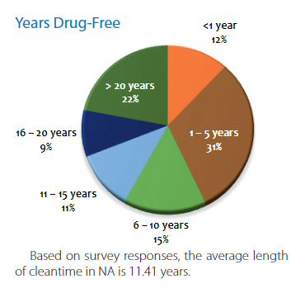
External Public
Our communication with the external public can show that NA is an effective, reliable, and responsive program of recovery
Our communication should be informative and should directly address any misconceptions the public may have
Honest and open communication with the external public helps NA retain its credibility & supports our ability to provide effective services
Notes:
1) NA Membership survey demonstrates that NA is effective in a variety of cultures, countries and languages.

Slide 30
How do we Communicate?
With each other in our meetings and service committees
With professionals and the general public when we are informing them about the program of Narcotics Anonymous
With professionals and the public when we are utilizing their services—public service announcements, meeting space, bus benches—to reach potential members
Directly with still-suffering addicts
Notes:
We can plan and target our communications for each identified audience such as Educators, healthcare workers, addiction specialists… Of course, we are always communicating a message about NA with our personal actions.

Slide 31
Communicate to Coordinate
Coordination strategies help us work toward a unified approach to providing services
Effective PR service depends on our ability to work together
Communication follow-up ensures that the area maintains an ongoing relationship with the public
Notes:
Coordination helps members of the NA community stay informed. Coordination strategies also ensure that groups are involved in communication efforts.

Slide 32
Public Relations Workshop
Part 2
Planning Presentations to the Public

Slide 33
Planning Presentations to the Public
We can show a public audience that we are reliable and knowledgeable by preparing and training for our interactions with them
Preparation and training can help improve our public interactions even if we consider ourselves as having experience
Notes:
Chapter 4 of PR Handbook

Slide 34
Preparation
Where?
Why?
Who?
What?
When?
How?

Slide 35
Preparation
WHERE ?
Personnel from schools, healthcare facilities, social service offices, treatment centers & Law Enforcement
Introduction letter – begin a dialogue and convey basic information about NA
Exhibits and booths at conferences and health fairs to reach out to pros who work with addicts
Notes:
We can use these events as an opportunity to make contacts within the community that may lead to presentations in the future.

Slide 36
Preparation
Why ?
The goal of the presentation is to leave the audience with a basic understanding of the NA program of recovery
demonstrate that NA is a valuable and credible community resource
Help us to fulfill our primary purpose
Notes:
The public can help us to carry out our primary purpose…

Slide 37
Preparation
WHO ?
Who is our audience? – Tailor the presentation to fit the interests of attendees
Who will be doing the presentation? – depends on service members available and experience.
Notes:
1. Research the organizations, what are their goals and mission.

Slide 38
Preparation: What do we want to communicate?
Origin of our name – not just for opiates
Brief history
Growth – 70,000 weekly meetings in 144 countries.(2018)
Our primary purpose and sole requirement for membership
Role of the group and NA Traditions –how groups and service bodies work to forward our message
NA Steps – description
NA is spiritual, not religious
Where/How to find us

Slide 39
Preparation
WHEN ?
Schedule a presentation during the time of the day that is most likely to be convenient for the participants

Slide 40
Preparation
HOW ?
Planning is a vital part of any presentation
Rehearse, Rehearse, Rehearse
Use familiar language, NOT NA LANGUAGE
Handouts or questionnaires – use familiar language as well
The presenters need time to prepare and to familiarize themselves with the materials before the presentation

Slide 41
The Presenters
Take a team approach – a good mix of members demonstrates our unity
Diversity is strength, serving together highlights our unity and is highly attractive to new members and to the people whom we are giving a presentation
Know the material you are presenting
Familiarize yourself with the FAQ’s

Slide 42
Appearance
Choose clothing that suits the setting
Think job interview
Diversity of members
Look professional, be professional

Slide 43
Tips for Success
Be prepared
Know your audience
Keep it local—bring local materials
Be knowledgeable about NA resources
Be enthusiastic
Keep the presentation within the allotted time frame
Be simple and direct
Listen
Learn to “read” the audience
Send a thank-you letter
Survey the audience
Use feedback to improve for next time
Share information about NA and minimize personal experience
Notes:
NA resources – membership survey, websites

Slide 44
Public Relations Goals
We clarify what services NA can and cannot provide to the community.
We make NA members more aware of their role in NA’s public image.
We aim for the public to recognize NA as a positive and reliable organization.
We develop valuable relationships with professionals and the general public.
Notes:
Once we start these relationships with the public, we must continue to develop those relationships by getting a point of contact for each organization and continue to follow up and stay in contact with them from time to time.

Slide 45
Developing Strong Relationships
Be active in our efforts
Create positive relationships with the public & professionals
Our Behaviors, attitudes & appearance can make all the difference in our public relations efforts

Slide 46
Core PR Principles
Strong Relationships
benefit both NA and Public Organizations
they are….
Ongoing
Flexible
Trustworthy
Respectful
Notes:
Use info from my old presentation….

Slide 47
Core PR Principles
strong relationships are ongoing and include
A Consistent dialogue
staying in touch with the organization
Give them reliable ways to contact us

Slide 48
Core PR Principles
Strong relationships are flexible
Organizations are flexible for us
We must be flexible for them

Slide 49
Core PR Principles
Strong relationship are trustworthy
The trust we build is a result of consistent, reliable and diplomatic service efforts
Acting with integrity builds trust

Slide 50
Core PR Principles
Strong relationships are respectful
When NA members respect each other, that respect is carried into our relationships with the public

Slide 51
Our primary purpose is to carry NA’s message to addicts around the world—many members of the public are more than happy to help us fulfill this purpose. We can do our part by presenting clear, reliable, and meaningful information about what NA is and how NA can help addicts.

Slide 52

QUESTIONS
Harold H
ALNWFLRSC

