Slide 1

DRT/MAT as it Relates to NA
Helping Members Take Root

Slide 2
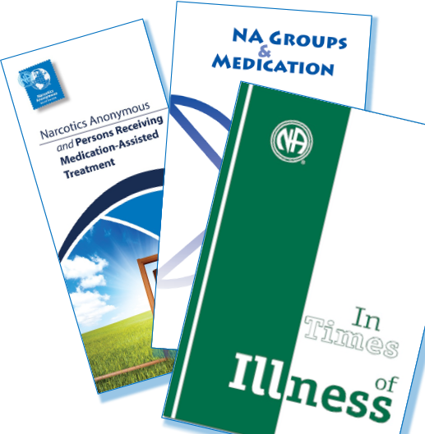
We’ve been having conversations around drug replacement therapy, or medication-assisted treatment (DRT/MAT) for decades.
It’s clear we don't have a unified Fellowship position on this issue.

Slide 3
It’s important to talk about because…
It is not going away
Medication is frequently part of treatment and may be mandated for compliance
We need to consider how to carry the message in the world we live in

Slide 4

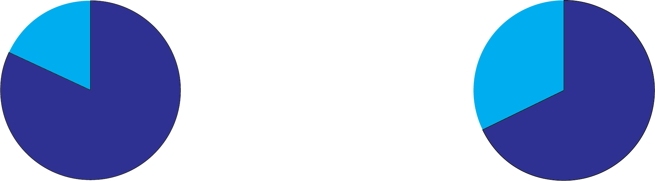
It is our job to make sure that recovery is available to anyone who wants it, and that it is attractive to those who need it.
If professionals are unwilling to refer people to NA, some addicts may never find us.
Most recent membership survey
82%
stayed in NA because of identification with other members
68%
said their first meeting was important or very important

Slide 5

Where we have consensus as a Fellowship
Our message is hope and the promise of freedom.
We are a program of complete abstinence.
It doesn’t matter what or how much you used.
What we care about is what you want to do about your problem and how we can help.
The only requirement for membership is a desire
to stop using.
We want people to be able to choose
NA membership no matter how they get here.
We want NA to be a safe place to recover.

Slide 6

Is there anyone here who has experience coming into NA on medication to treat addiction and now living drug free?
Would you be willing to share a few thoughts
on your experience?

Slide 7

Small Group Discussion
We are going to talk about how each of us finds a sense of belonging in NA and how we help to cultivate that for each other.
What were some of the ways you felt your membership was challenged early in your recovery, and what made you “stick and stay”?
How do we help people feel
rooted and secure in NA?

Slide 8

Large Group Discussion
What is one thing that was shared that stood out for you in the small group discussion?

Slide 9

Our Third Tradition offers relief from reservations we
might have about membership and
about each other.
Guiding Principles,
“Tradition Three”

Slide 10

We need to go deeper
and consider what it means to move from “someone who goes to some meetings sometimes” to being a member of NA.
As a program of complete abstinence, how do we help people feel included enough to be able to choose whether to be an NA member?
How do we help each other understand membership and take root in NA?

Slide 11
It Works: How and Why, Tradition Three – “The group is not the jury of desire…. No addict should be denied an opportunity to stay long enough to develop that desire. We can nurture that desire with loving acceptance.”
“…we are encouraged to open wide the doors of our meetings to any addict who wishes to join. We are asked to extend to others the care and concern that helped each of us find a sense of belonging.”
How do we make space for a newcomer to surrender – even if it takes a long time?
How can we set aside some of our own fear and judgment about members who come in on DRT/MAT to focus on helping addicts find a home in NA?

Slide 12
Share your ideas by filling out the
form on www.na.org/survey
This is one of four IDTs this cycle.
The other three are:
Dealing with disruptive and predatory behavior
Reimagining and revitalizing service committees
Gender Neutral and Inclusive
Language in NA Literature
As workshop material is available, it will be posted to www.na.org/idt

