Slide 1
reaching our common goals PLANNING
supporting our primary purpose

Slide 2
COLLABORATION
“CO-LABOR”
“If we are acting in goodwill—doing the right thing for the right reasons—we are sure to benefit. Each of us has something to give…”
Living Clean, Chapter Seven, “The Journey Continues”

Slide 3
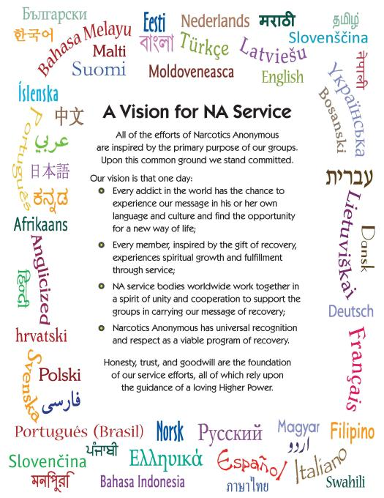
This is our future as a Fellowship

Slide 4
so, why plan?
Efficiency is doing things right. Effectiveness is doing the right things
More effective group influence
Realize
Our
vision
If there is no planning, often a service body will move forward in a status quo fashion – staying stuck on “this is the way we have always done it”.

Slide 5
who plans?
current trusted servants
committee members
members no longer involved in service
new members
invite all members to participate

Slide 6
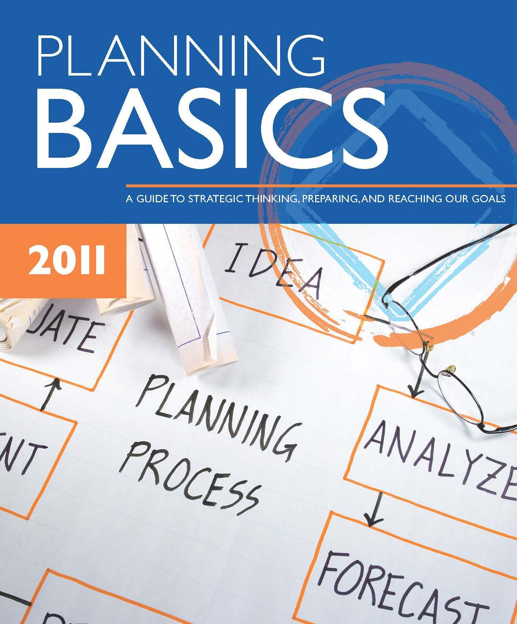
Planning Basics

Slide 7
the planning cycle
GATHERING
INFORMATION
IDENTIFYING AND PRIORITIZING ISSUES/ BRAINSTORMING GOALS AND SOLUTIONS
CREATING PROJECT PLANS
MONITORING AND EVALUATING
THE PLANNING CYCLE

Slide 8
seven components of planning
gather information
list and prioritize the issues
develop goals (identify “what,” not “how”)
prioritize goals
create approaches (actions to reach goals)
prioritize approaches (a second look)
develop action plans

Slide 9
routine services
do not change much from month to month
do not require a project plan to continue
considered when determining what resources are available for projects

Slide 10
project based services
have a beginning and an end
members with special interest or skills serve for a shorter time
may help improve existing routine services, or result in new ongoing services
may happen on a regular basis−not part of the prioritization process

Slide 11
brainstorm and prioritize an issue brainstorm and prioritize goals and approaches (solutions) create an action plan
large group planning exercise
who, what, when, how much, and who monitors?

Slide 12
Discussion/Feedback

Slide 13
“Participating without seeking the illusion of control sets the model for the rest of our lives. In whatever capacity we find ourselves, we serve NA with dedication and love when we serve with humility.”
ww.na.org/handbooks
RESOURCES
Living Clean, Chapter Seven, “The Journey Continues”

